Slide 1
Assignment 2B Presentation EECE 443 Team 2: MCU TNC Design Kaleb Leon – C00094357 Kobe Keopraseuth – C00092349 David Cain – C00043561 April 2nd, 2020

Slide 2
MCU TNC Assignment 2B
David Cain, Kobe Keopraseuth, and Kaleb Leon

Slide 3
Agreements
Explaining how our design considered specified needed considerations in public health, safety, welfare, as well as global, cultural, social, environment, and economic factors.
Provide an OSI type, layered communications model for the whole communications stack
Make flowchart more readable
Flowchart is incomplete.
Grammatical Errors

Slide 4
Disagreements
Appendices do not contain a coversheet
- Not necessary since we already have titles for each appendix
Provide a state a state diagram for the process and show how you validated the flow chart and state diagram.
- We don’t think it is necessary for this point of the design
Acronyms, used in Appendix D, should have a clearer description in case the reader is unfamiliar with the subject matter.
- Acronyms are described previously in paper.
Needs a level 2 diagram
- Not specified in the requirements for assignment 2
Flowcharts for receiving and transmitting sides need to cycle back
Each flowchart is simulating with one packet and reaches the end of the process at the last block of each flowchart.
Label interconnections on wiring schematics
- A key with what each wire’s color represents in the wiring schematics in Figure D-6.

Slide 5
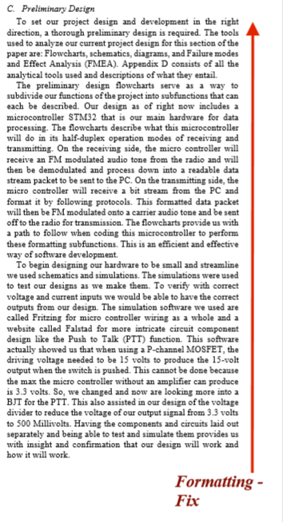
What do you mean?

